Slide 1
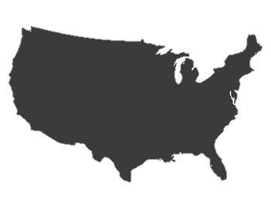
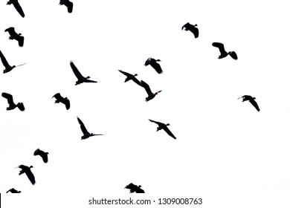
SURVEILLANCE AND MONITORING OF TARGET AND NON-TARGET SPECIES AVIAN INFLUENZA VIRUS
Mini Project by Charlotte Fryday

Slide 2
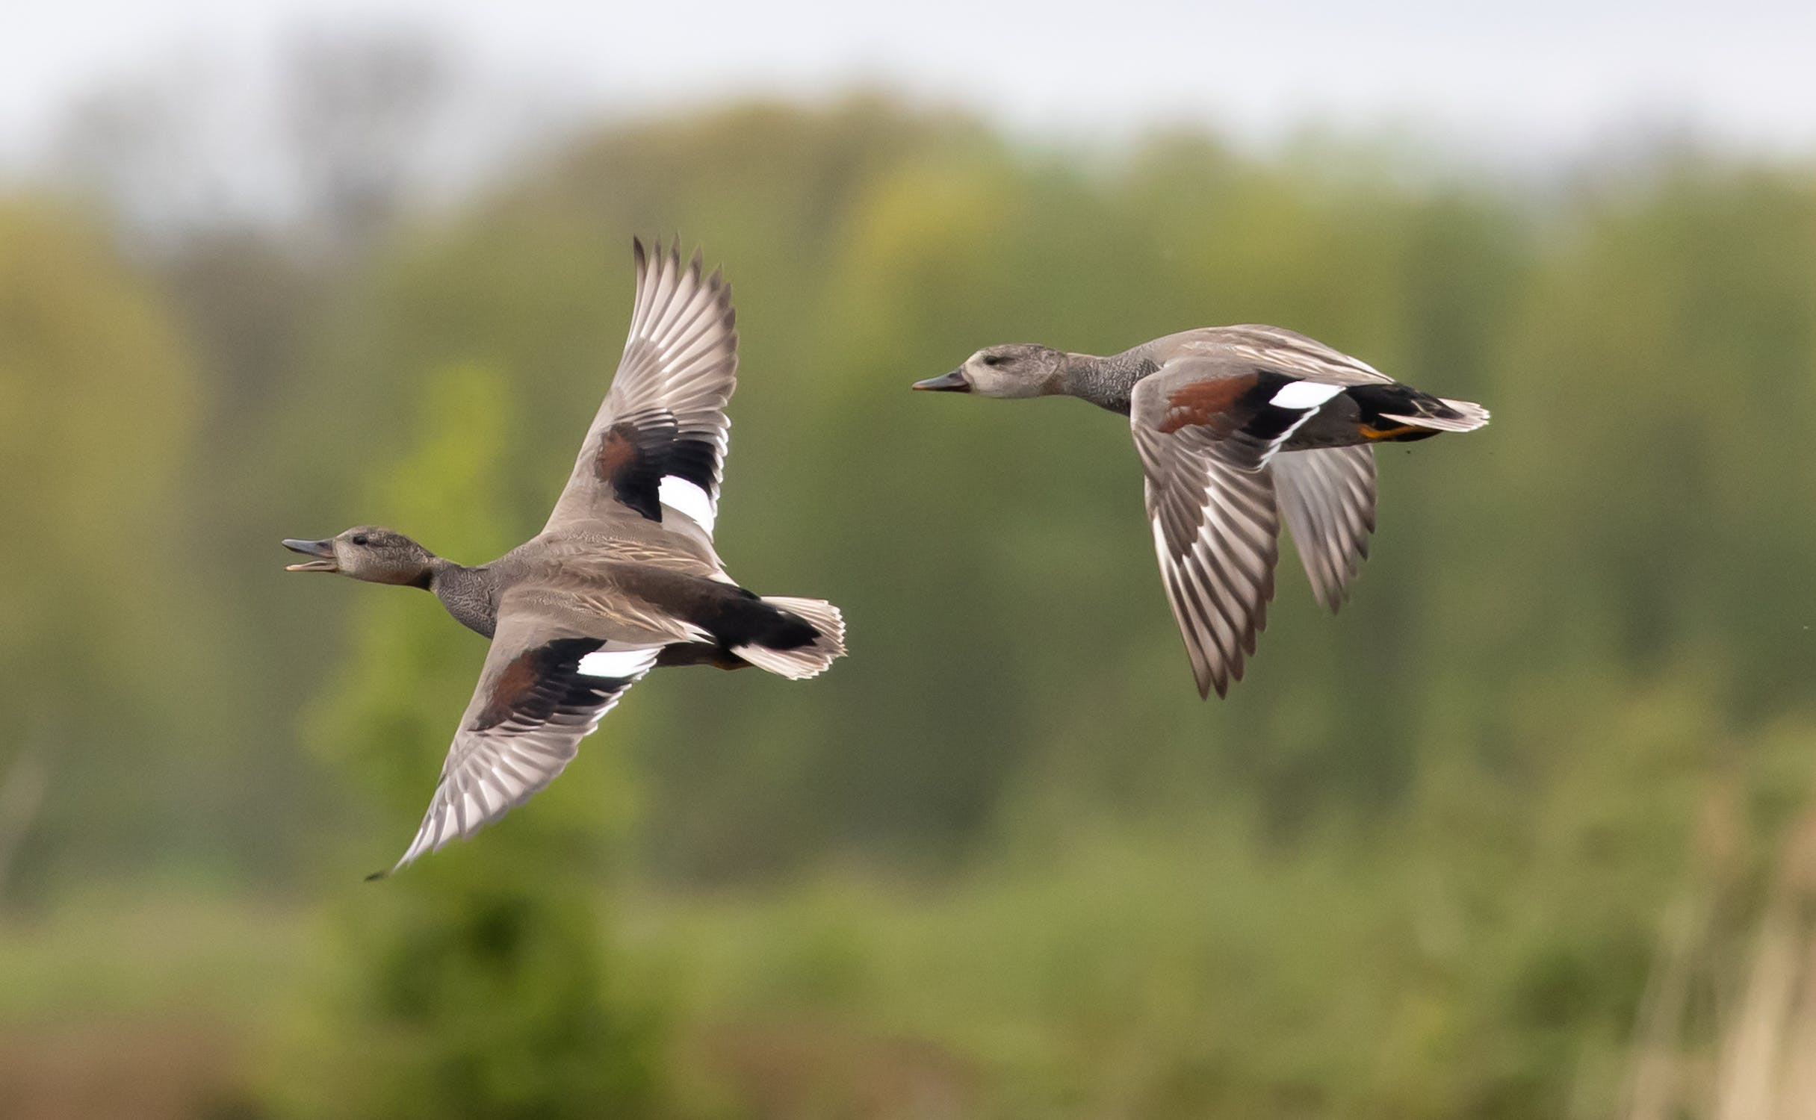
Introduction
1. Background – avian influenza
2. The dataset
3. Research question
4. Methods
5. Results
6, Conclusions and Future work

Slide 3
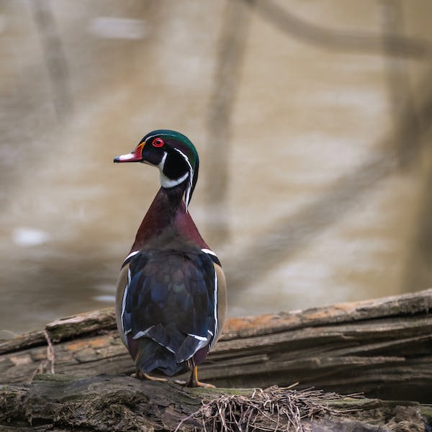
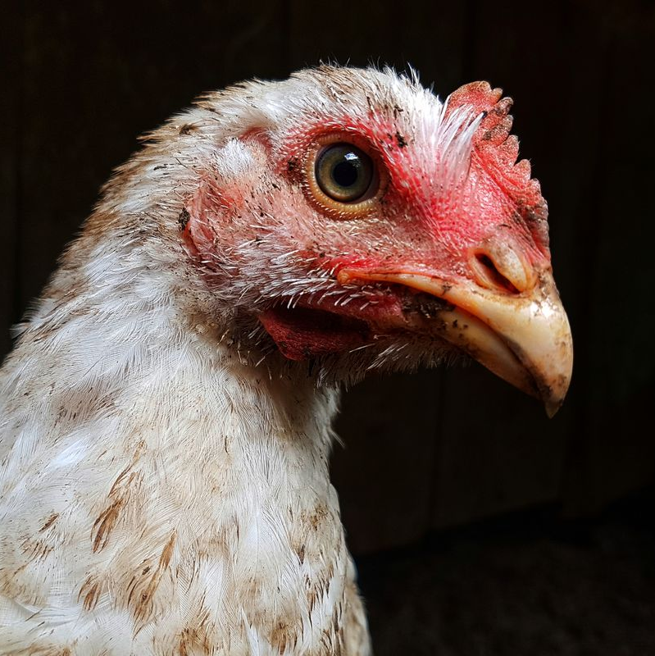
Avian Influenza
Recent increase in its detection globally
Risk for the wildlife and poultry industry
Wild migratory birds => primary reservoirs
Need for effective monitoring strategies

Slide 4
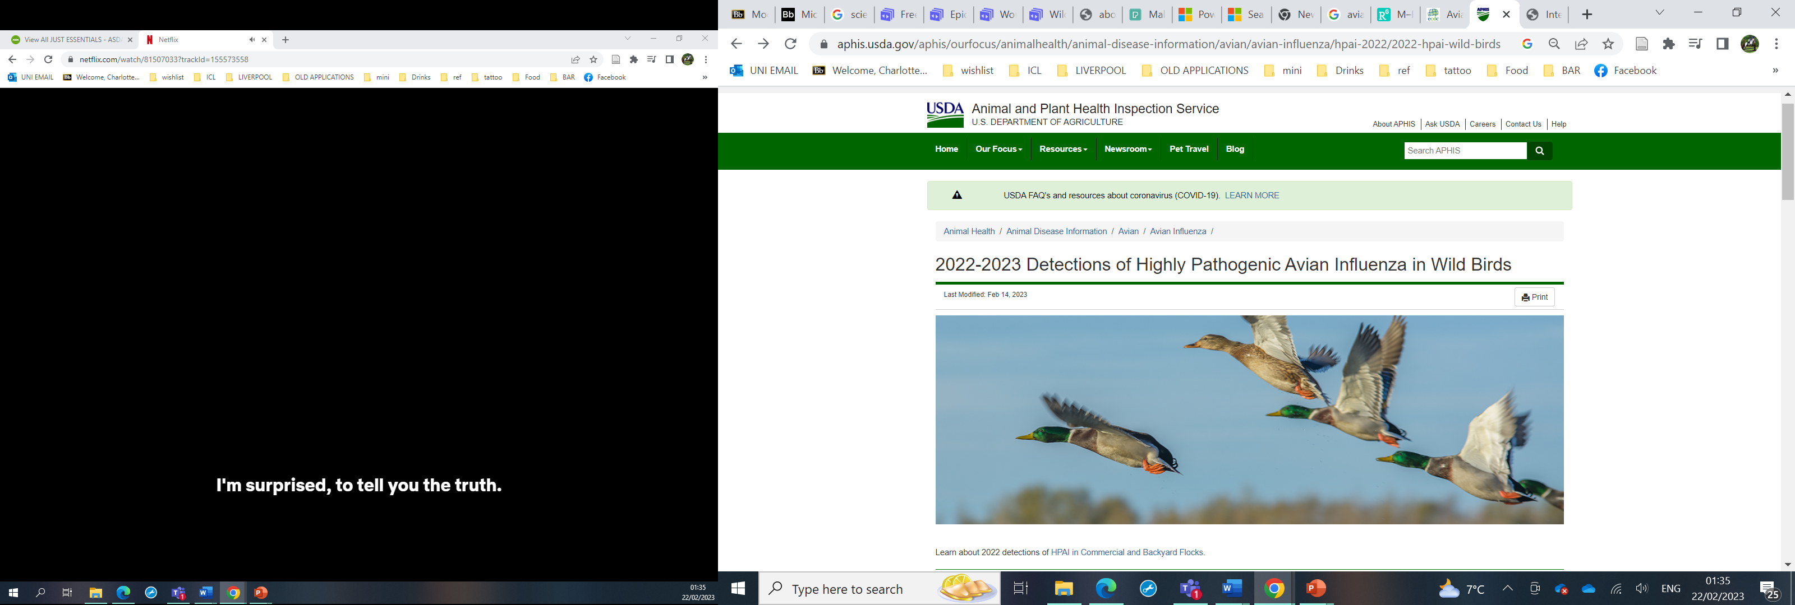
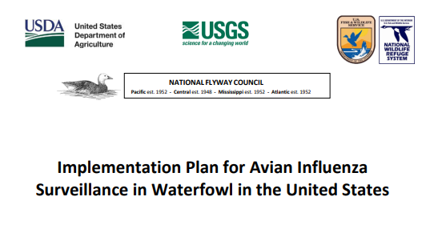
The dataset
Records of the detection of highly pathogenic avian influenza in wild birds in the United states 2022 including location (state) and date (month)
Records of detection from:
→ Strategic monitoring of live target species
→ Dead birds of all species

Slide 5

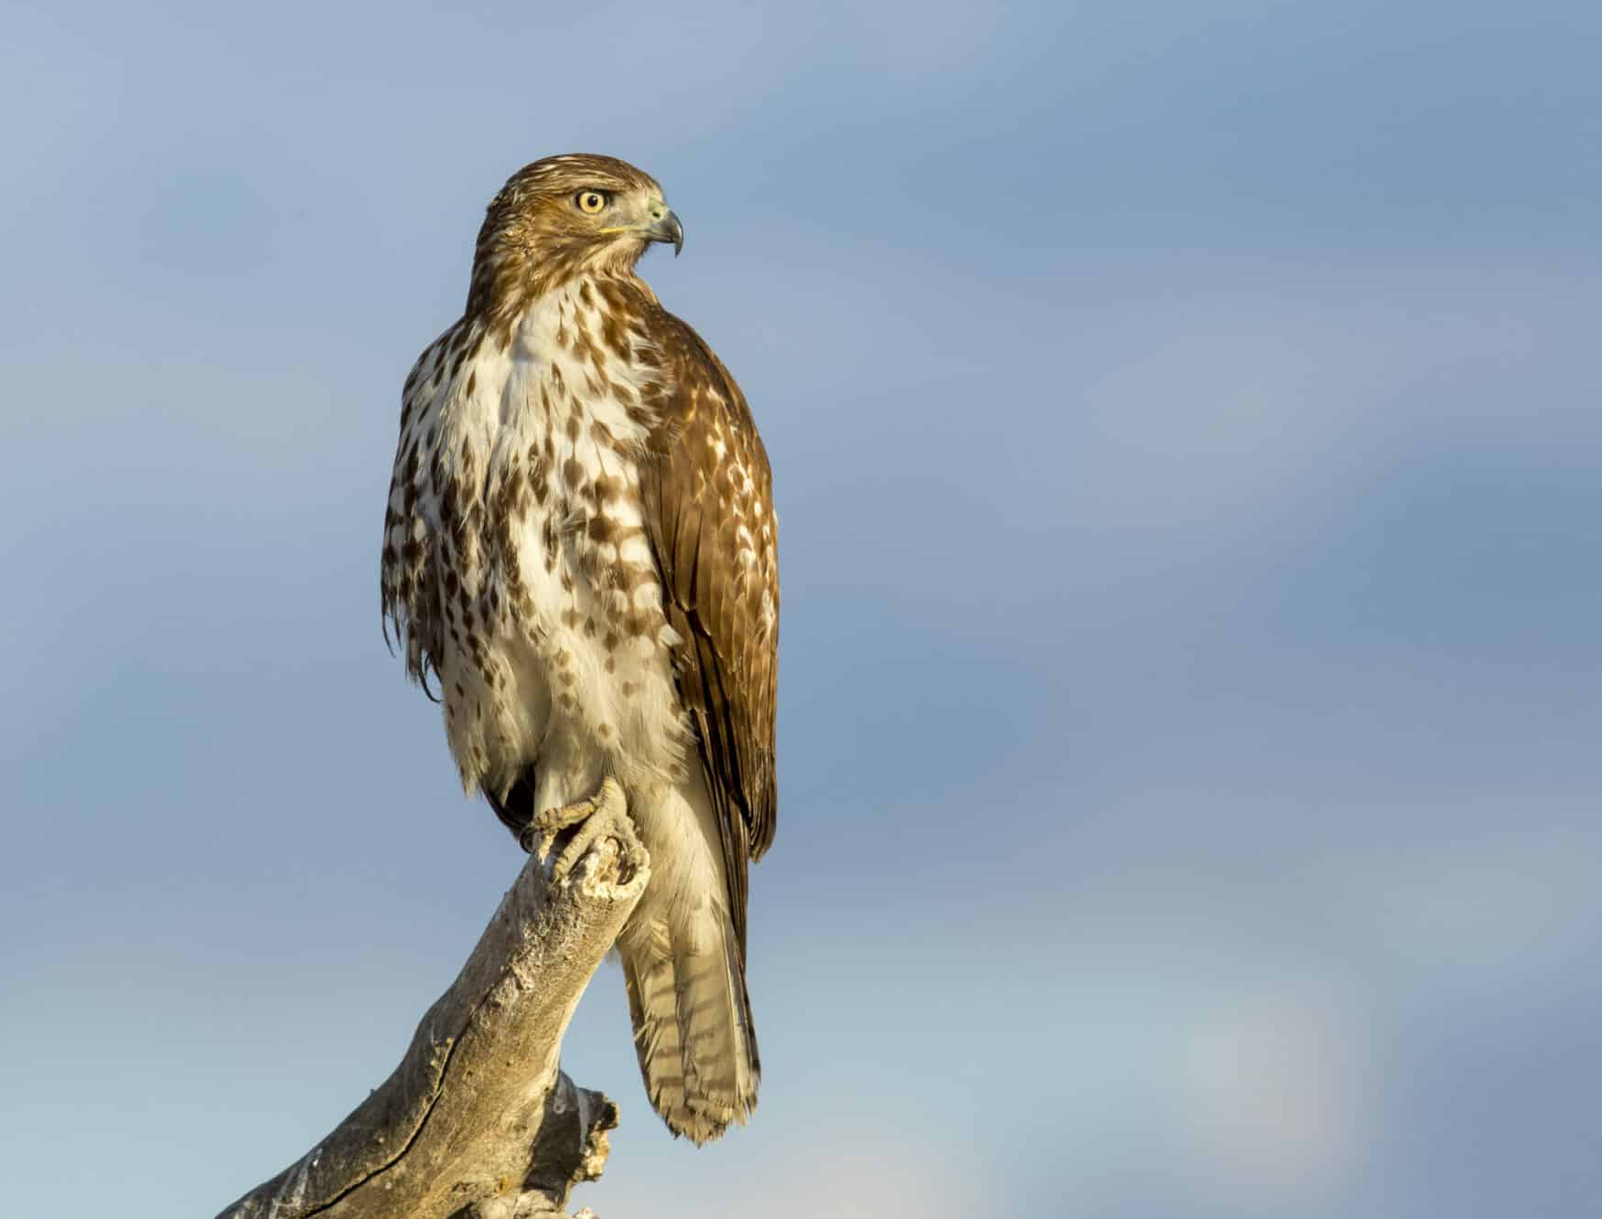
- Split the data between target and non-target species and summarized the counts for State and Month. - Generalized linear mixed effect model, Poisson distribution Hypothesis: In HPAI positive detections the deaths of non-target species is predicted by the occurrence in target species. Formula: Nontarget ~ logTarget + (1|Month:State)
Methods
Target Species for Wild Bird AIV Surveillance
American Green-winged Teal | Mallard
Northern Pintail | American Black Duck
Wood Duck | Blue-winged Teal
Cinnamon Teal | Northern Shoveler
Mottled Duck | American Wigeon
Gadwall | Muscovy Duck
Fulvous Whistling Duck*
*not taxonomically a dabbling duck

Slide 6
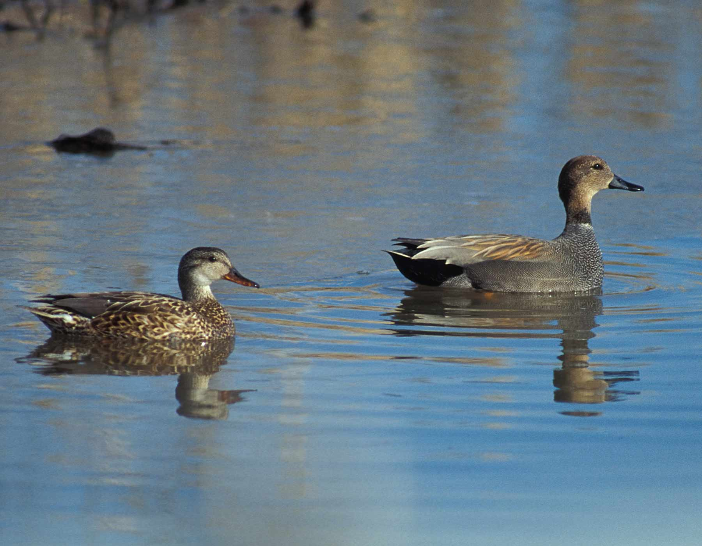
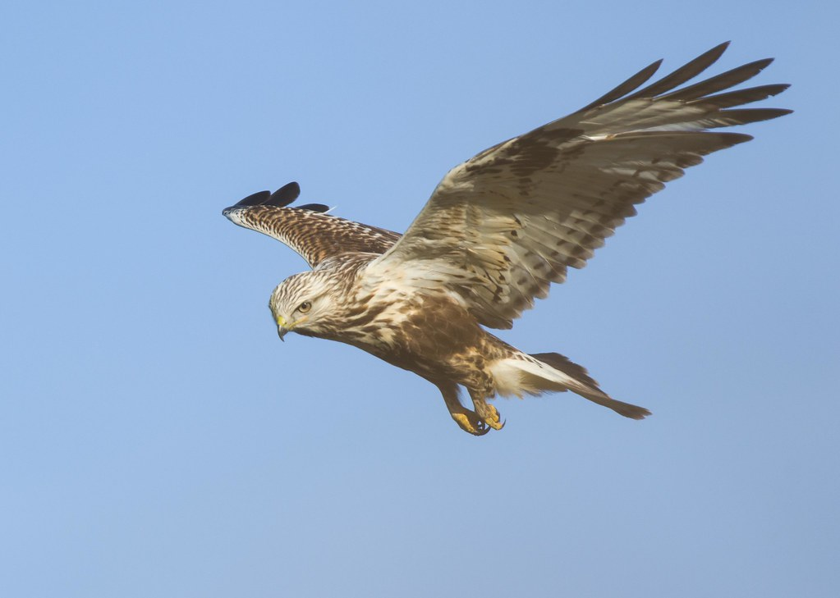
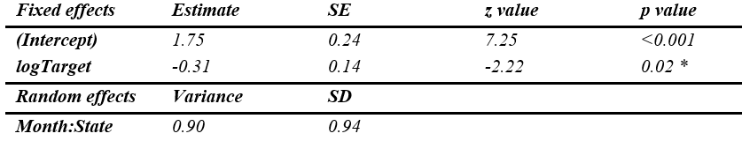
Results
HPAI detection data for 606 birds → 324 target and 282 non-target
In 24 states over 7 months
SIGNIFICANT
→ As the number of detections in target species increased the number of detections in mortality cases decreased.

Slide 7
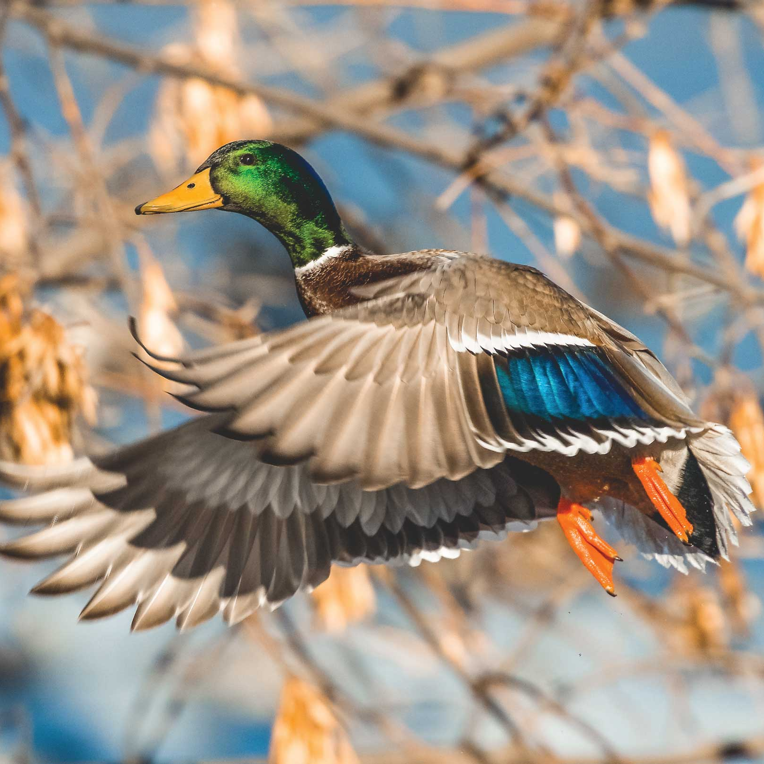
Conclusions and future work
Results were different to what was expected.
Could be significant
Lack of detections of mortality do not equate to the absence of disease
- We need more data collected over larger time periods
- Employment of larger efforts to collect cases of mortality

Slide 8
References
Alkie, T.N., Lopes, S., Hisanaga, T., Xu, W., Suderman, M., Koziuk, J., Fisher, M., Redford, T., Lung, O., Joseph, T., Himsworth, C.G., Brown, I.H., Bowes, V., Lewis, N.S. and Berhane, Y. (2022). A threat from both sides: Multiple introductions of genetically distinct H5 HPAI viruses into Canada via both East Asia-Australasia/Pacific and Atlantic flyways. Virus Evolution, 8(2). doi:https://doi.org/10.1093/ve/veac077.
Brown, J.D. and Stallknecht, D.E. (2008). Avian influenza virus: Wild Bird Surveillance for the Avian Influenza Virus. Humana Press, pp.85–97.
Hoye, B.J., Munster, V.J., Nishiura, H., Klaassen, M. and Fouchier, R.A.M. (2010). Surveillance of Wild Birds for Avian Influenza Virus. Emerging Infectious Diseases, 16(12), pp.1827–1834. doi:https://doi.org/10.3201/eid1612.100589.
Kelly, T.R., Pandit, P.S., Carion, N., Dombrowski, D.F., Rogers, K.H., McMillin, S.C., Clifford, D.L., Riberi, A., Ziccardi, M.H., Donnelly-Greenan, E.L. and Johnson, C.K. (2021). Early detection of wildlife morbidity and mortality through an event-based surveillance system. Proceedings of the Royal Society B: Biological Sciences, 288(1954). doi:https://doi.org/10.1098/rspb.2021.0974.
R Core Team (2022). R: A language and environment for statistical computing. R Foundation for Statistical Computing, Vienna, Austria. https://www.R-project.org/
Shi, J., Zeng, X., Cui, P., Yan, C. and Chen, H. (2022). Alarming situation of emerging H5 and H7 avian influenza and effective control strategies. Emerging Microbes & Infections, 12(1). doi:https://doi.org/10.1080/22221751.2022.2155072.
USDA (2018). Surveillance Plan Methods for Detecting Avian Influenza in Wild Migratory Birds in the United States.
USDA (2022a). 2022 Detections of Highly Pathogenic Avian Influenza in Wild Birds. [online] USDA.gov. Available at: https://www.aphis.usda.gov/aphis/ourfocus/animalhealth/animal-disease-information/avian/avian-influenza/hpai-2022/2022-hpai-wild-birds [Accessed 11 Feb. 2023].
USDA (2022b). Implementation Plan for Avian Influenza Surveillance in Waterfowl in the United States.

